Slide 1
Machine-Assisted Extraction of Formal Semantics from Domain Specific Semi-Formal Diagrams MOMACS 2019
Eric Davis, Alec Theriault,
Eddy Westbrook, Ryan Wright
This research was generously supported by the ASKE program under
DARPA-PA-18-02-AIE-FP-039

Slide 2
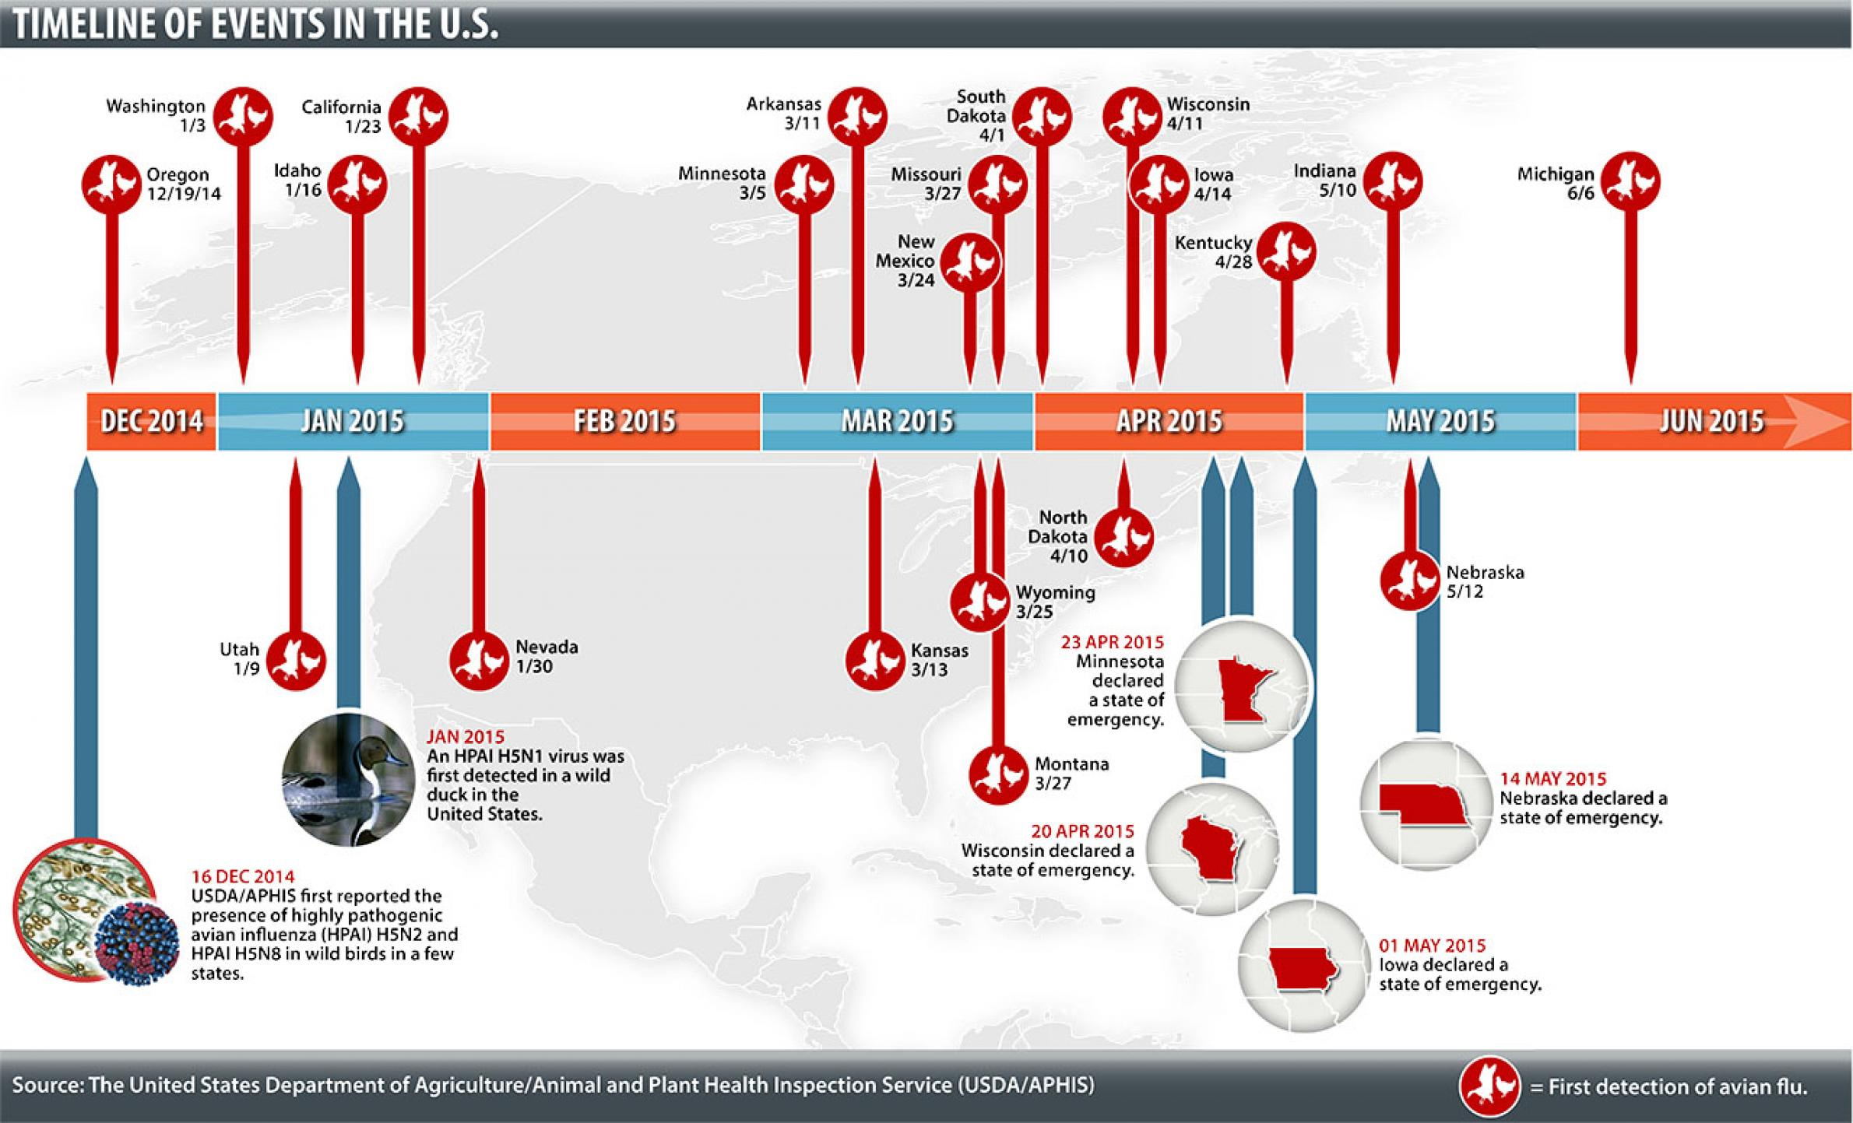
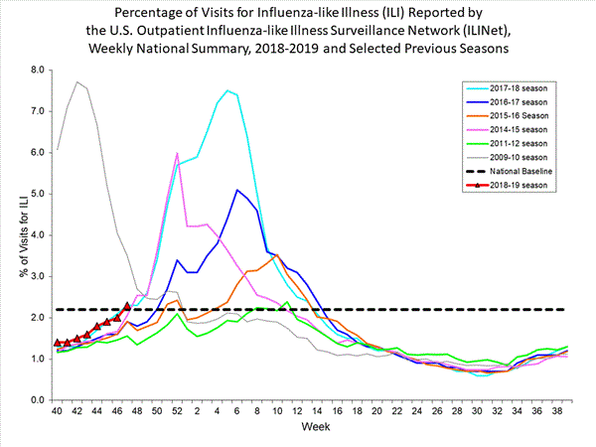
Modeling and Crisis Response: The Ideal
Domain experts capable of agile, performable, and high confidence modeling in response to crisis.
Leverage models to make decisions on actions, policy, with continuous improvement and feedback to improve outcomes.

Slide 3






Modeling and Crisis Response: The Reality
Building models of complex systems:
Requires large teams of modelers, mathematicians, and software engineers.
Not reusable.
Not maintainable.
Not easily developed.
Not performable.

Slide 4
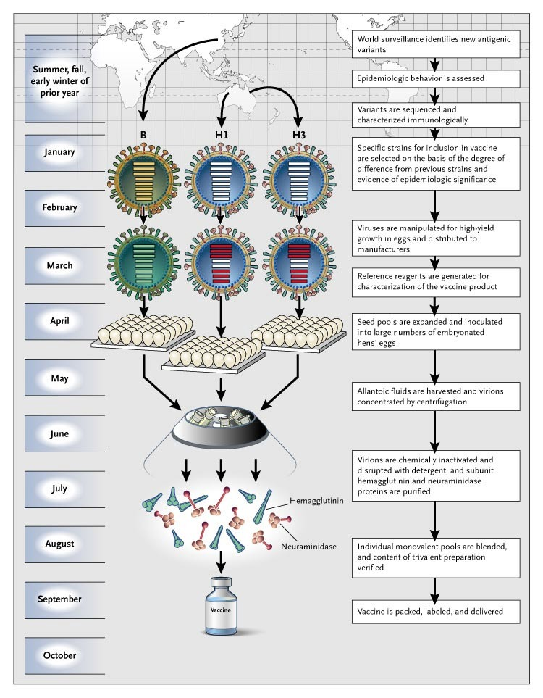
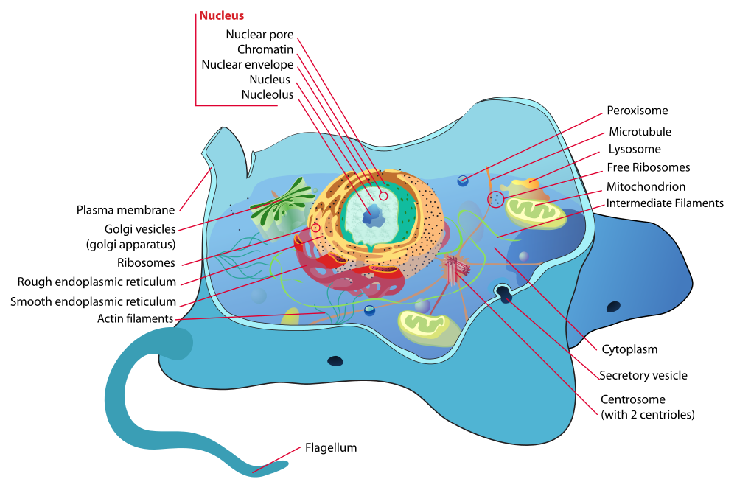
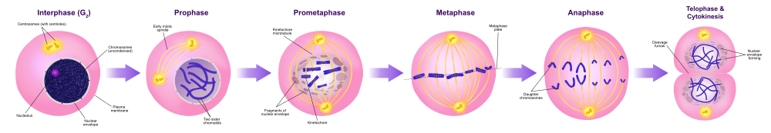
Semi-Formal Diagrams

Slide 5
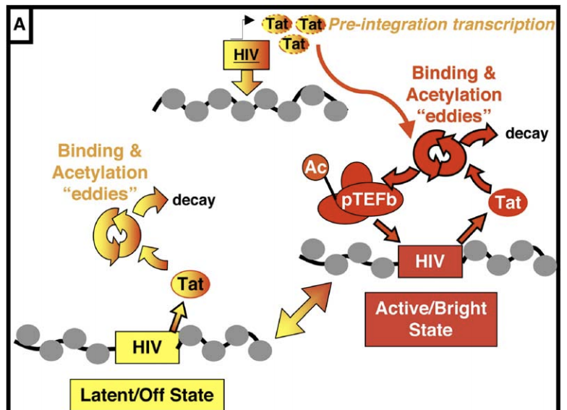
Tat Transactivation Model
Weinberger et al, “Stochastic Gene Expression in a Lentiviral Positive-Feedback Loop: HIV-1 Tat Fluctuations Drive Phenotypic Diversity“, Cell, 2005.

Slide 6
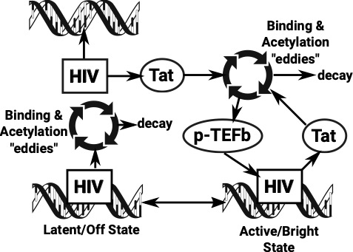
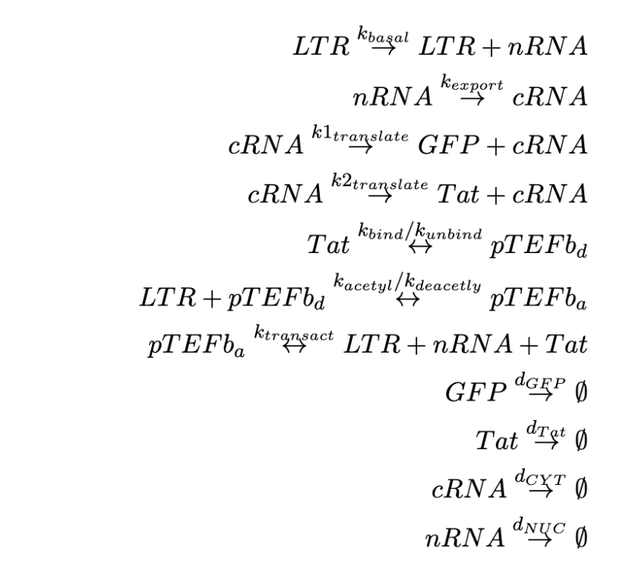
Tat Transactivation Model

Slide 7
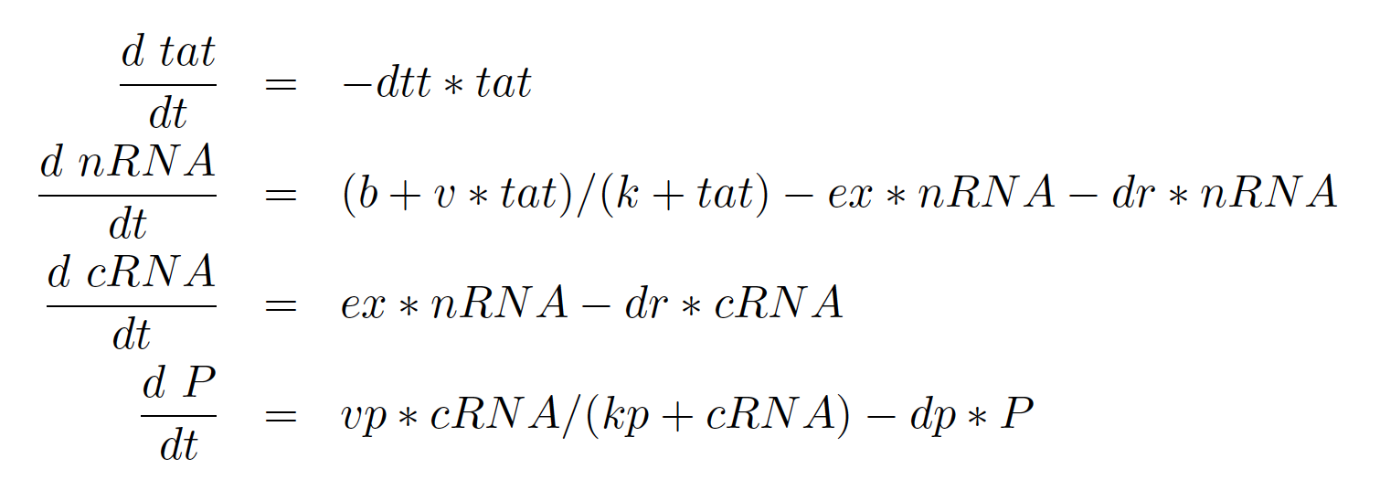
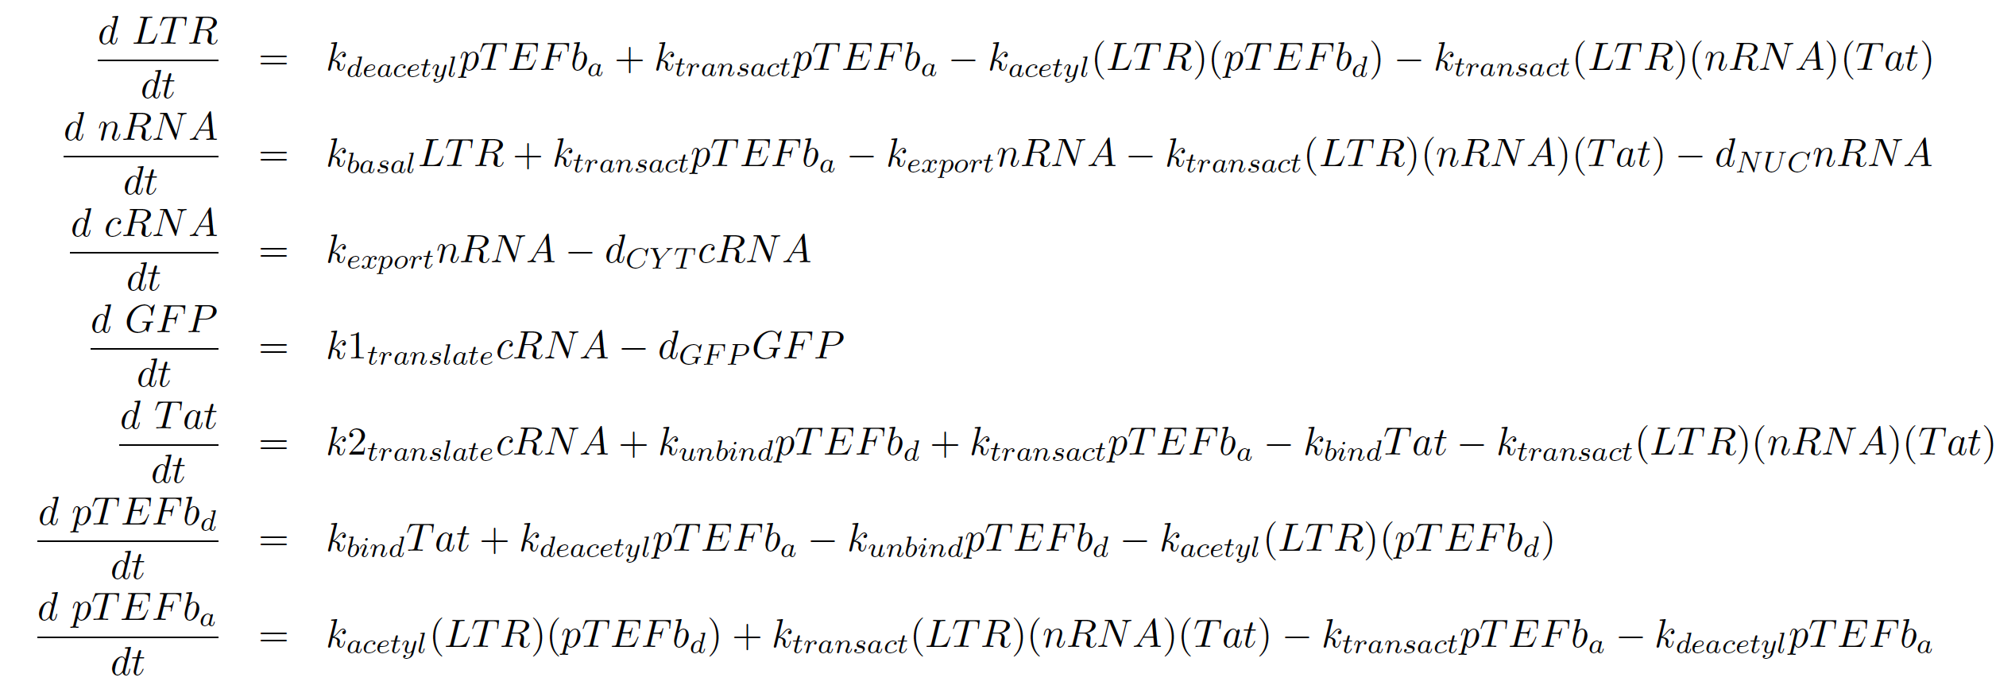
Tat Transactivation Model

Slide 8
AMIDOL Organization

Slide 9
AMIDOL Modeling Process

Slide 10




Visual Languages for Practitioners
Give mathematical meaning and executable syntax for diagrams.
Translate results back into explainable context.

Slide 11
Visual Domain Specific Ontological Languages

Slide 12
Abstract Intermediate Representation
Ground visual language in mathematical primitives in the form of an intermediate language.
Allows us to construct models from visual language.
Allows us to communicate results bound to mathematical constructs, using the visual ontology.

Slide 13
Putting it Together

Slide 14
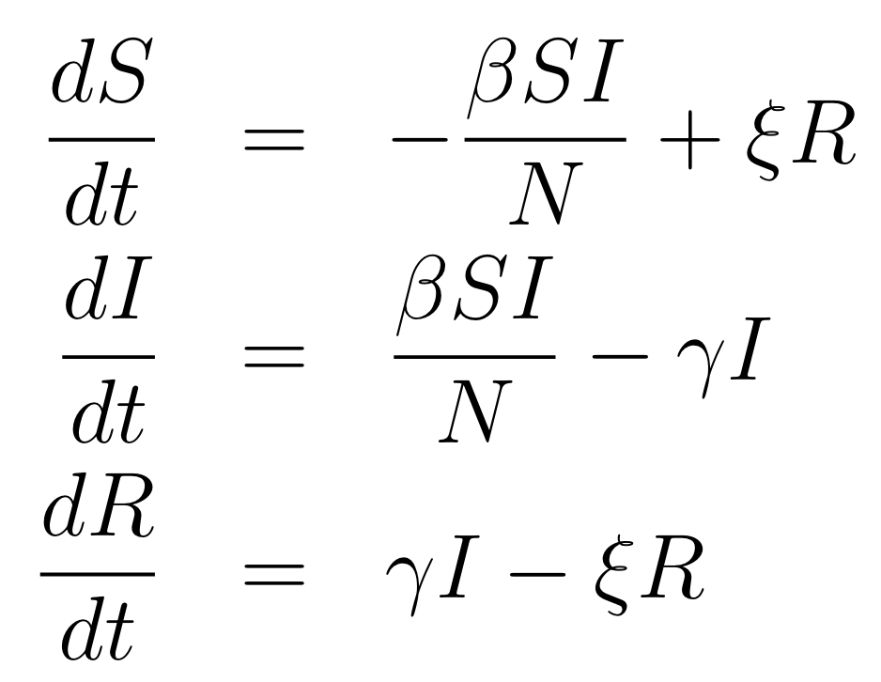
Putting it Together

Slide 15
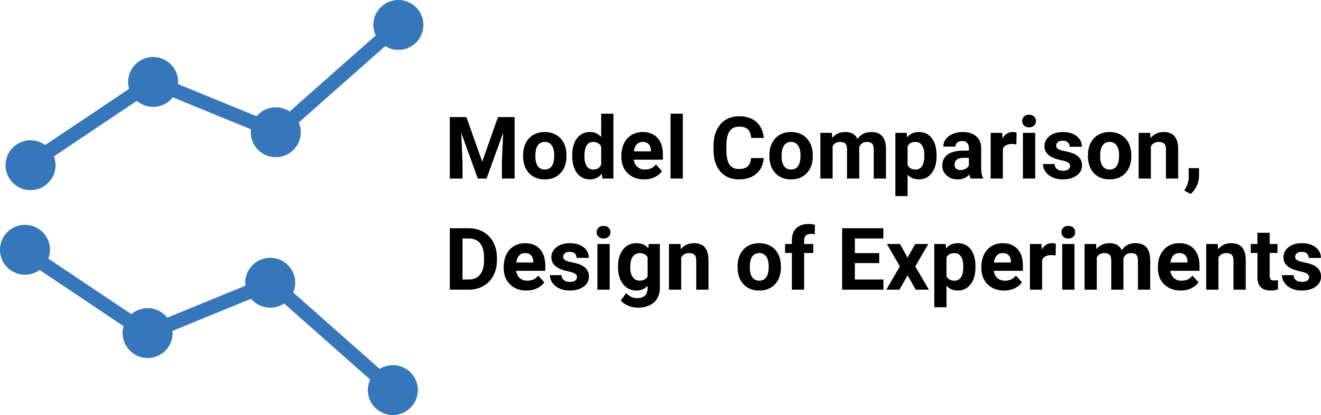
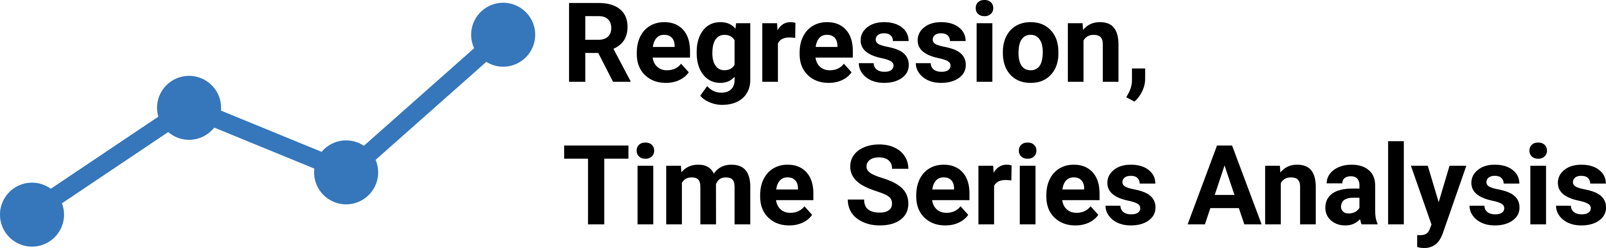
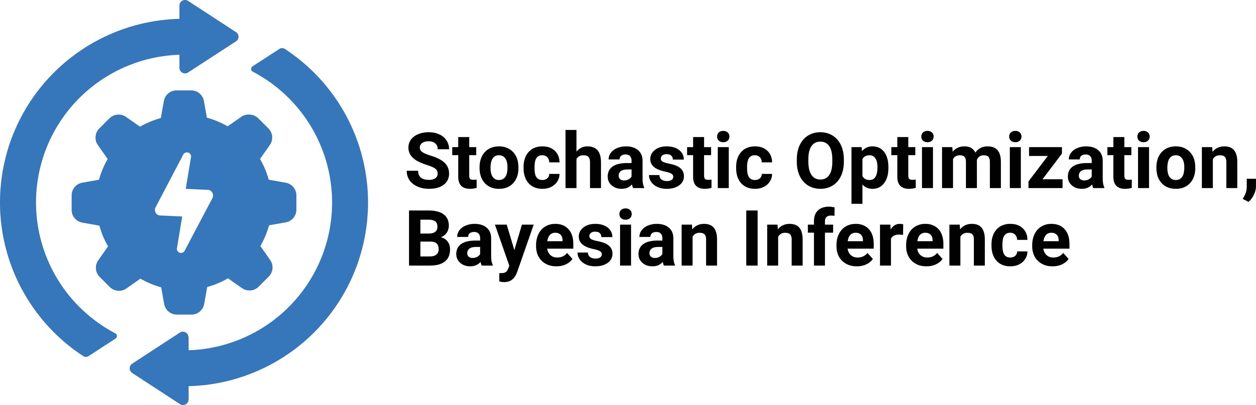
Interrogatability
Prediction
How will the system evolve in the near future?
Risk assessment:
What is the risk of X?
Conditional forecasting
How will the system respond if X changes?
Counterfactual analysis
What would have happened if X had been Y?
Comparative impact
What is the difference in utility between strategy X and strategy Y?
Optimal planning:
What is the optimal amount of X to introduce to maximize utility Y?
Risk assessment:
What is the risk of X?
Outcome avoidance:
What is the optimal action or intervention to reduce the risk of X decreasing more than Y?

